Slide 1



PROJECT 1:
STUDENT MATH
Data Science 2023/2024

Slide 2








Raoudha Hajji
Oumayma Jebali
Tesnim Nefzi
Yesmine Mejri
Nermine Melki Amdouni
Page
02

Slide 3

01
Introduction
07
Statistical modeling
02
Libraries
07.1
Hierarchical Ascending Classification(HAC)
OVERVIEW
03
Data Understanding
07.2
Identification of factors
04
Data Preparation
05
Univariate analysis
06
Bivariate analysis
Page
03

Slide 4


INTRODUCTION
school
sex
age
family size
parent status mother education travel time
study time
class failures school support family support extra paid classes higher ed
free time
health
absences
final grade
student’s school
student’s sex
student’s age
family size
parent’s cohabitation status
mother’s education
home to school travel time
weekly study time
number of past class failures
extra educational support
family educational support
extra paid classes within the course
wants to take higher education
free time after school (from 1 - very low to 5 - very high)
current health status ( from 1 - very bad to 5 - very good) number of school absences
final grade
This dataset contains student achievement data for two high school Students.
The data was collected using school reports and questionnaires.
Page
04

Slide 5

Page
05
LIBRARIES
purrr
dplyr
ggplot2
patchwork
visdat
tidyr
factoextra
VIM
FunCluster
caret
corrplot
cluster
tidyverse

Slide 6
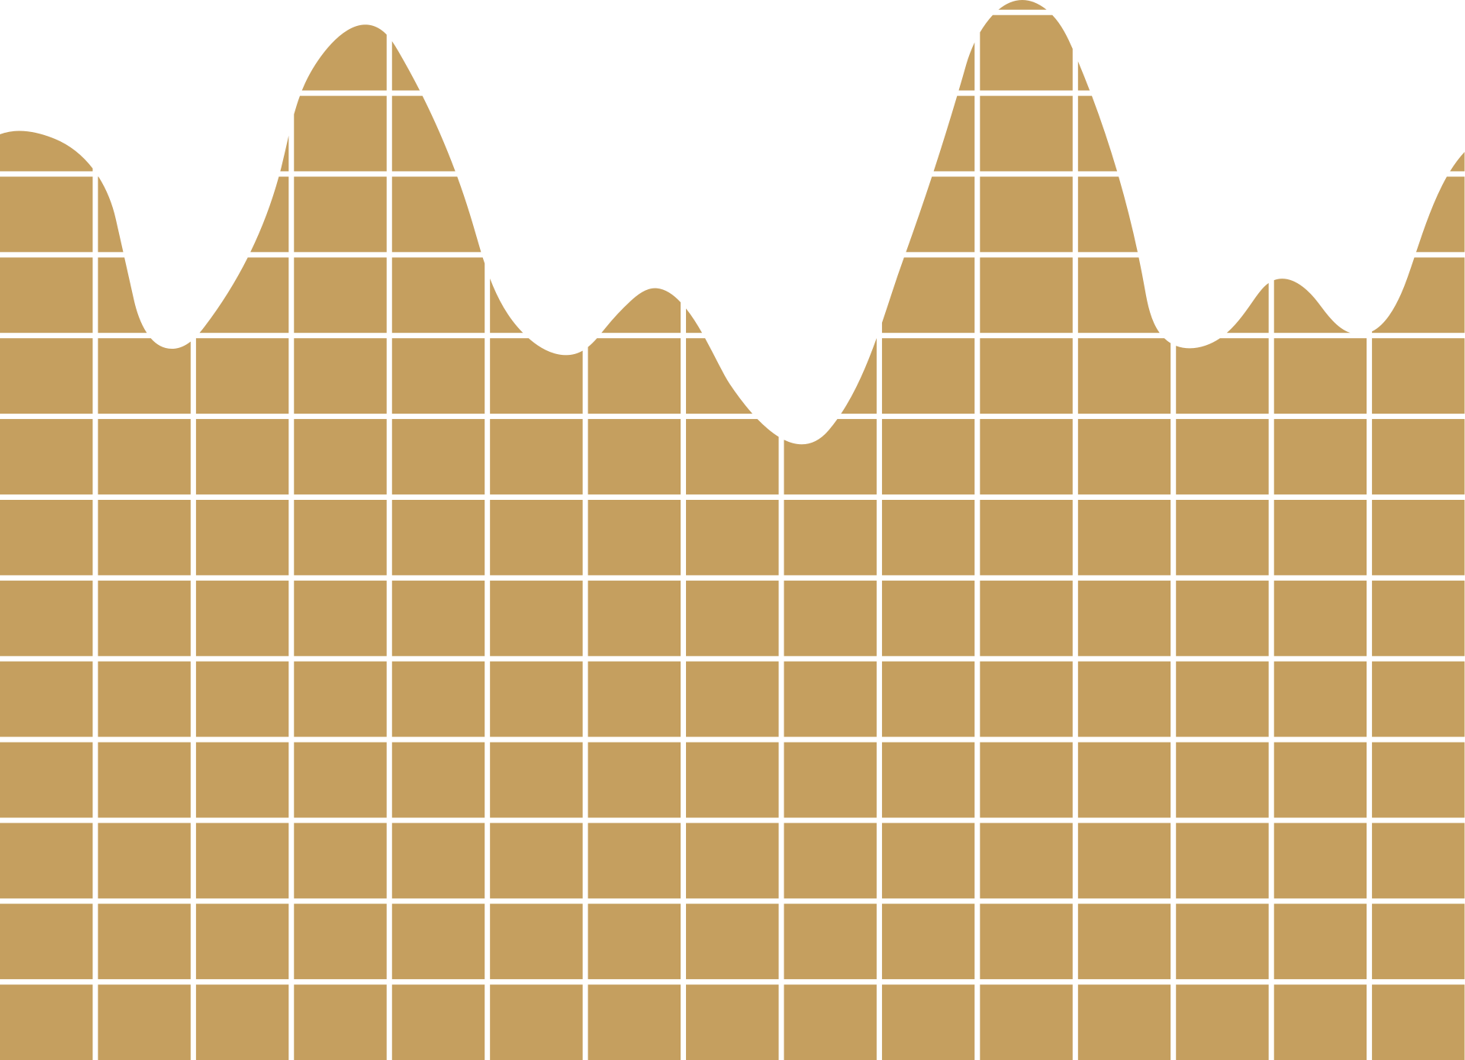
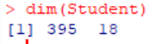
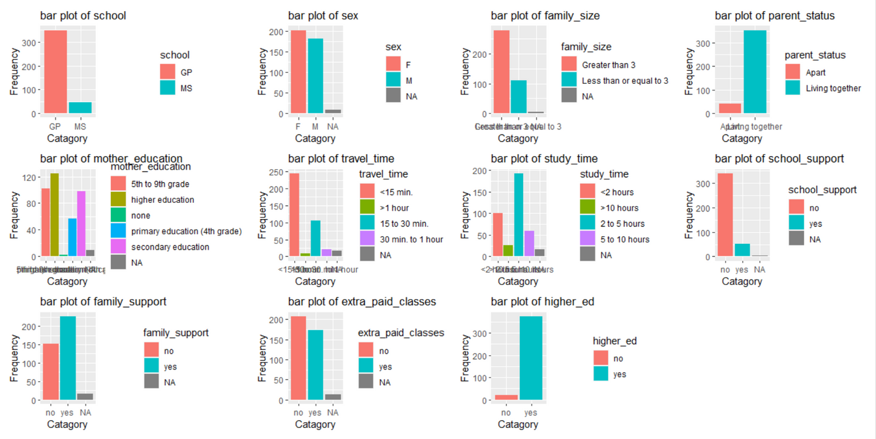
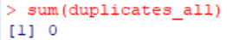
Page
06
DATA UNDERSTANDING
Categorical Columns Visualization
11 Categorical columns
7 Numerical columns
No Duplicates

Slide 7

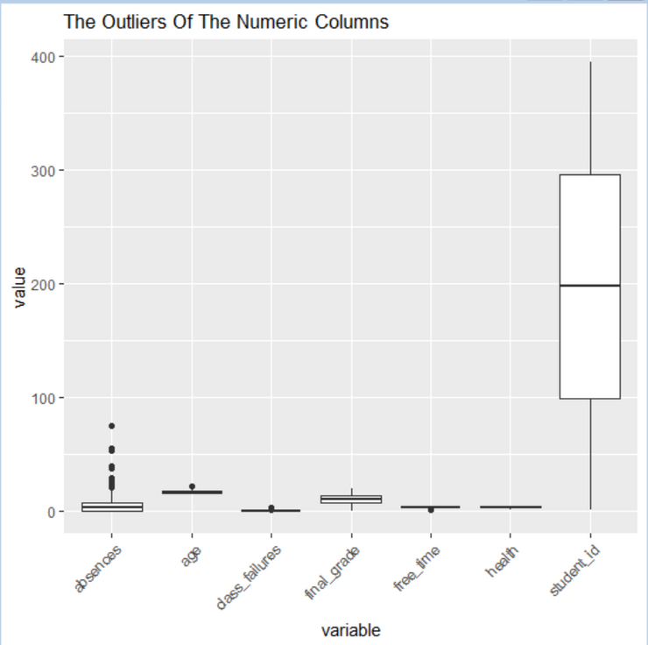
Page
07
DATA PREPARATION
Outliers
We used Tukey’s method to identify the Outliers numericaly.
We assigned NA values to the Outliers .

Slide 8

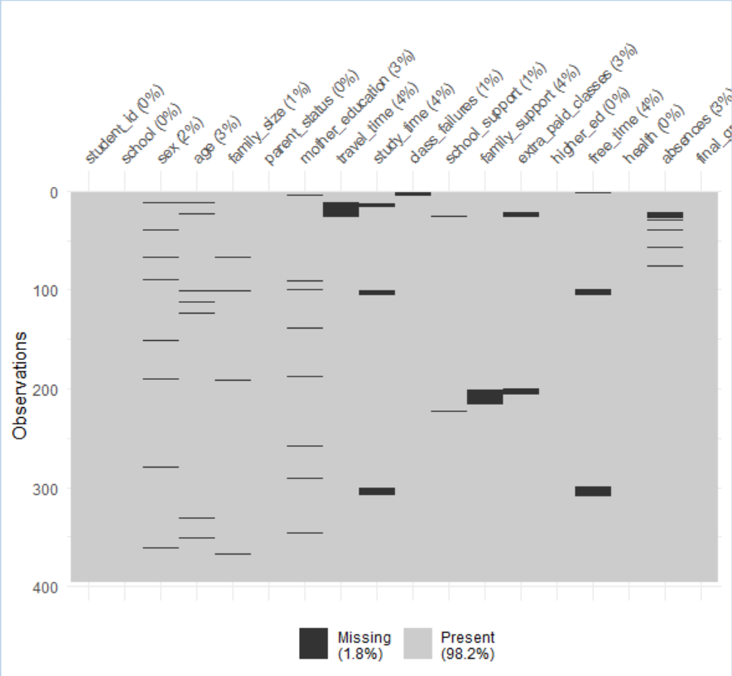
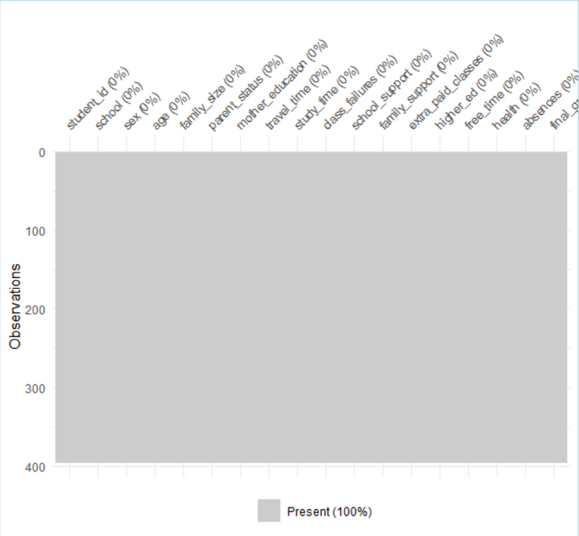
Page
08
DATA PREPARATION
Missing Values
We used the KNN method to impute the missing values.

Slide 9
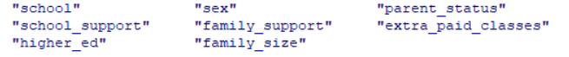
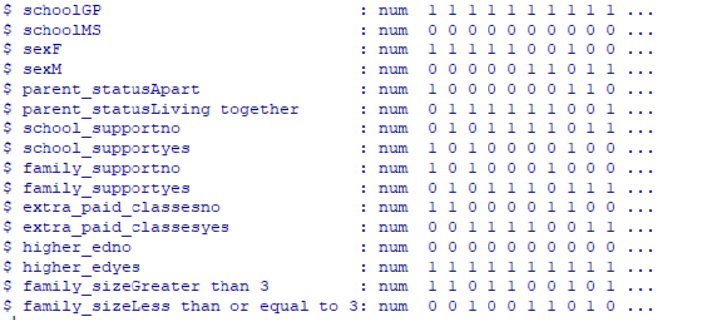
Page
09
DATA PREPARATION
DATA ENCODING
Nominal columns
We used the One Hot encoding method to encode them

Slide 10
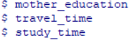
Page
10
DATA PREPARATION
DATA ENCODING
Ordinal columns
We used the Label encoding method to encode the ordinal columns

Slide 11

Page
11
DATA PREPARATION
DATA ENCODING
Ordinal columns
We used levels to order each column from low to high
we take the column travel_time to explain:
<15 min takes 1
15 to 30 min takes 2
30 min to 1 hour takes 3
> 1 hour takes 4

Slide 12

UNIVARIATE ANALYSIS
Univariate analysis of variables consists of studying the characteristics of each variable
Perform graphical representations and study normality for quantitative variables.
Examine the distribution of categories, determine relative frequencies and make gra-
phical representations to better explain qualitative variables.
Page
12

Slide 13
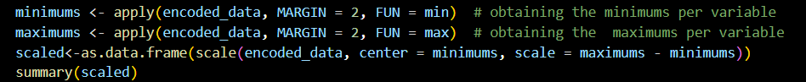
Normalization
Page
13

Slide 14
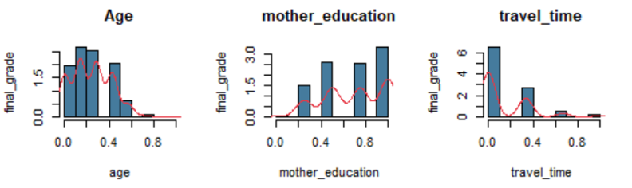
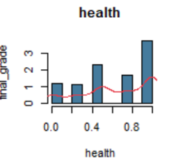
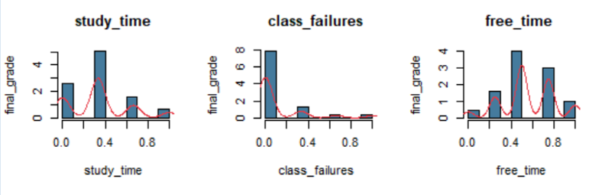
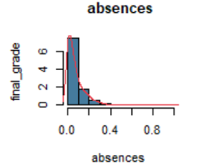
Visualization
Page
14

Slide 15
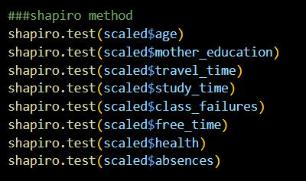
Shapiro-Wilk test
Page
15
p_value<0.05 : reject H0 et accept H1
none of these variables follows the normal law

Slide 16
BIVARIATE ANALYSIS :
Study the correlation between the variables (two by two).
Validate the results with appropriate hypothesis tests.
Page
16

Slide 17


CORRELATION:
H0: r=0 => two independant variables
H1: r≠0 => two dependant variables
Page
17

Slide 18
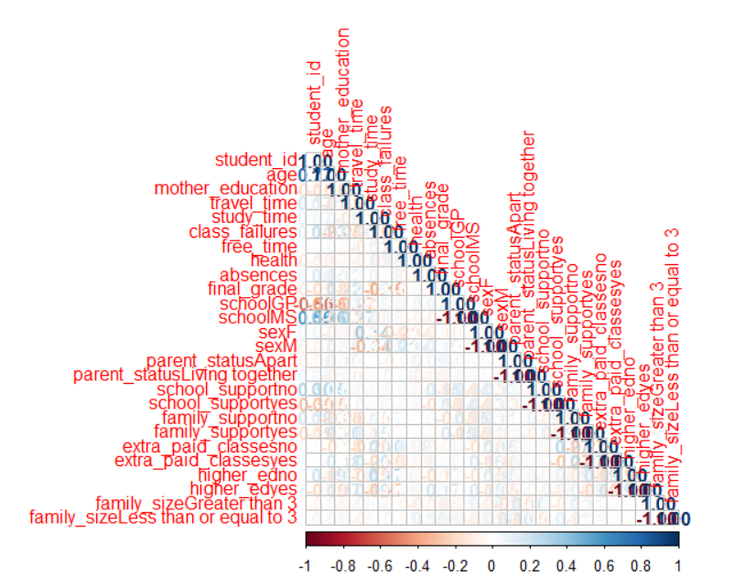

After some research, we discovered that there is an easier way to define the correlation between the variables which is the correlation matrix. It is a method to better visualize the differences.
Page
18

Slide 19
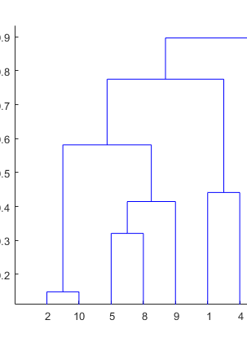
Page
19
HIERARCHICAL CLUSTERING
is an Unsupervised non-linear algorithm in which clusters are created such that they have a hierarchy(or a pre-determined ordering).
Hierarchical clustering is of two types:
Agglomerative
Divisive
It starts at individual leaves and successfully merges clusters together. Its a Bottom-up approach.
It starts at the root and recursively split the clusters. It’s a top-down approach.

Slide 20
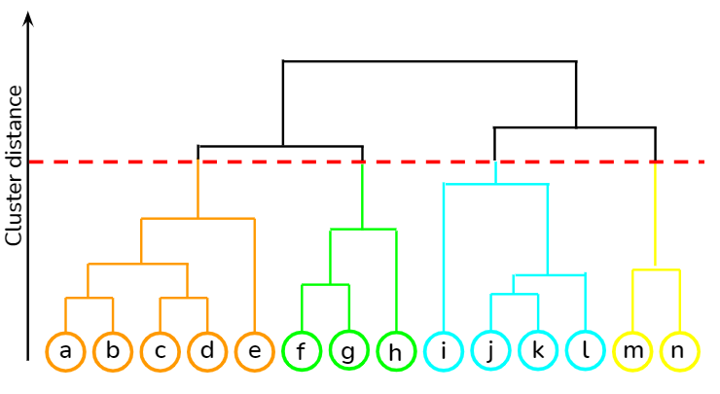
HAC STEPS
Make each data point in a single point cluster that forms N clusters.
Take the two closest data points and make them one cluster that forms N-1 clusters.
Take the two closest clusters and make them one cluster that forms N-2 clusters.
Repeat steps 3 until there is only one cluster.
Dendrogram is a hierarchy of clusters in which distances are converted into heights
Page
20

Slide 21
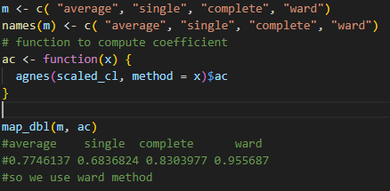
HAC: METHOD CHOICE
Page
21

Slide 22
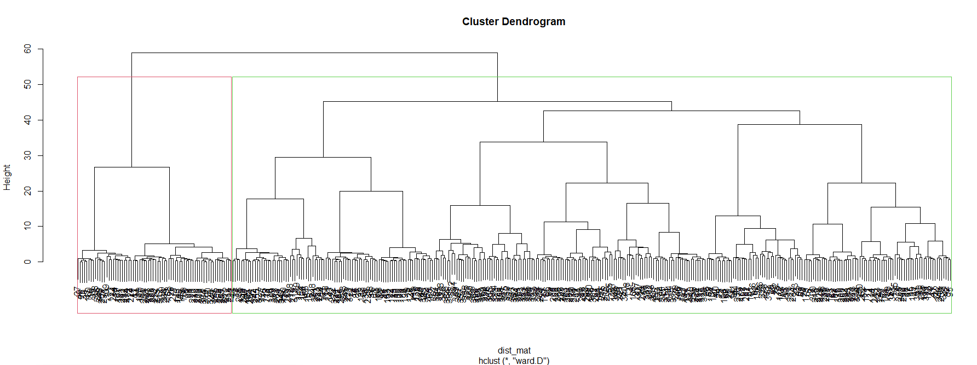
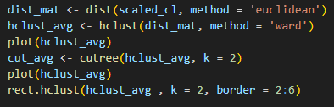
CHA PLOTTING
Page
22

Slide 23
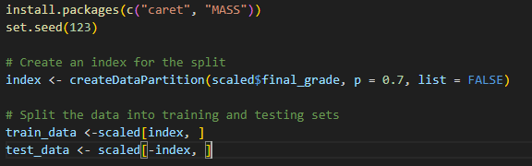
MODELING
Data splitting
We split our dataset into two subsets to be able to create models and evaluate them:
train dataset is for building the model
test dataset is for evaluating the model
Page
23

Slide 24

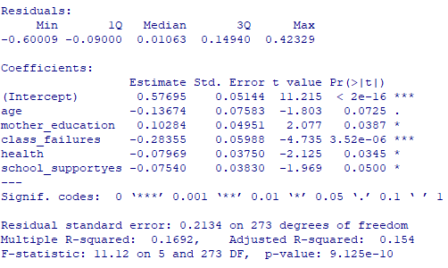
MODELING
Linear Regression
The lm command takes the variables in the format:
lm([target] ~ [predictor / features], data = [data source])
With summary(model) you can see detailed information on the model’s performance and coefficients.
Page
24

Slide 25

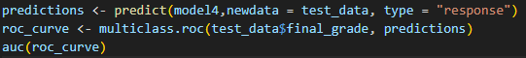
Page
25
EVALUATION
AIC criterion
The smaller the AIC value, the better the model fit.
ROC criterion

Slide 26
THANK YOU
FOR YOUR ATTENTION
Data Science Students

